Slide 1
Module 2: RAID & Intelligent Storage Systems
Dr. S. Nandagopalan

Slide 2
Syllabus
Module 2 (8 hours)
Chapter 3: Data Protection - RAID
RAID Implementation Methods
RAID Array Components
RAID Techniques
RAID Levels
RAID Impact on Disk Performance
RAID Comparison.
Chapter 4: Intelligent Storage Systems
Components of an Intelligent Storage System
Types of Intelligent Storage Systems
Chapter 5: Fibre Channel Storage Area Networks - Fibre Channel
Overview
The SAN and Its Evolution
Components of FC SAN

Slide 3
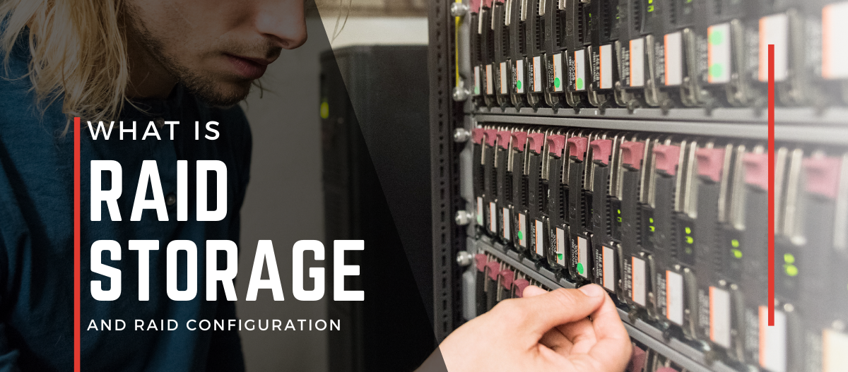

Chapter 3:

Slide 4
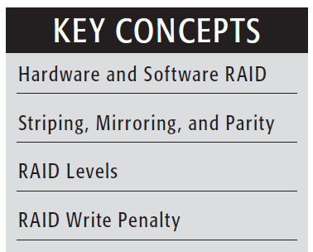
Introduction
Redundant Array of Independent Disks
RAID - virtual disk technology that combines multiple physical drives into one unit.
Today’s data centers house hundreds of disk drives in their storage infrastructure.
The two methods of RAID implementation are hardware and software

Slide 5
Software RAID
Software RAID uses host-based software to provide RAID functions – OS level – no hardware controller
Drawbacks:
Performance: additional CPU cycles required to perform RAID calculations
Supported features: Software RAID does not support all RAID levels
Operating system compatibility: tied to the host operating system

Slide 6
Hardware RAID
Specialized hardware controller is implemented either on the host or on the array (RAID controllers on motherboards)
Key functions of the RAID controllers are as follows:
Management and control of disk aggregations
Translation of I/O requests between logical disks and physical disks
Data regeneration in the event of disk failures

Slide 7
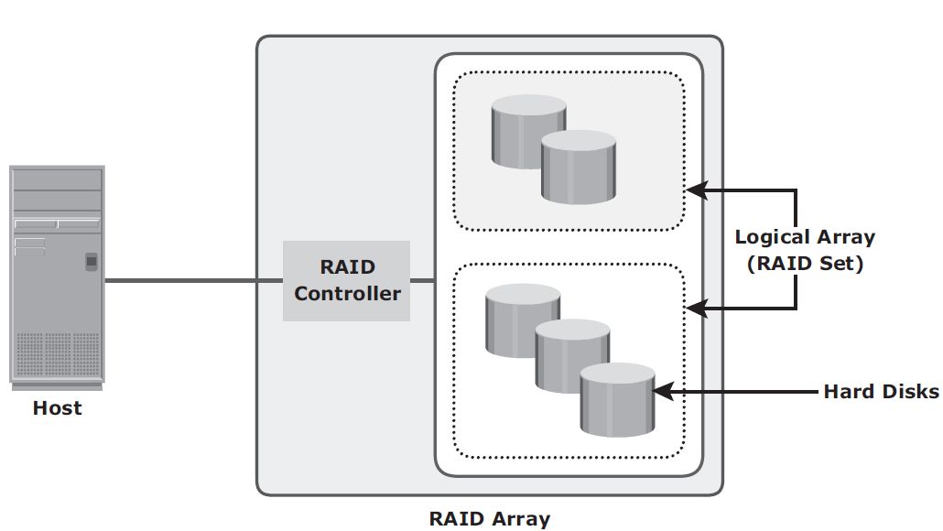
RAID Array Components

Slide 8
RAID Techniques
RAID techniques — striping, mirroring, and parity — form the basis for defining various RAID levels.
These techniques determine the data availability and performance characteristics of a RAID set.

Slide 9
Striping
Spread data across multiple drives (more than one) to use the drives in parallel.
All the read-write heads work simultaneously, allowing more data to be processed in a shorter time and increasing performance, compared to reading and writing from a single disk.
Strip - Within each disk in a RAID set, a predefined number of contiguously addressable disk blocks
Stripe - The set of aligned strips that spans across all the disks within the RAID set

Slide 10
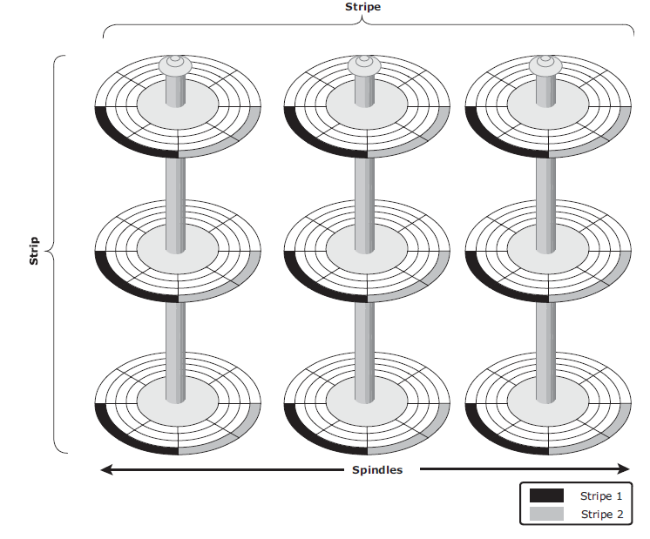
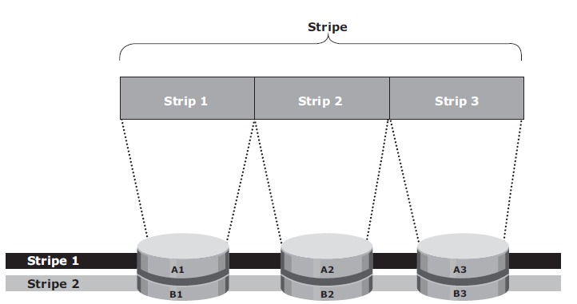
Striped RAID set

Slide 11
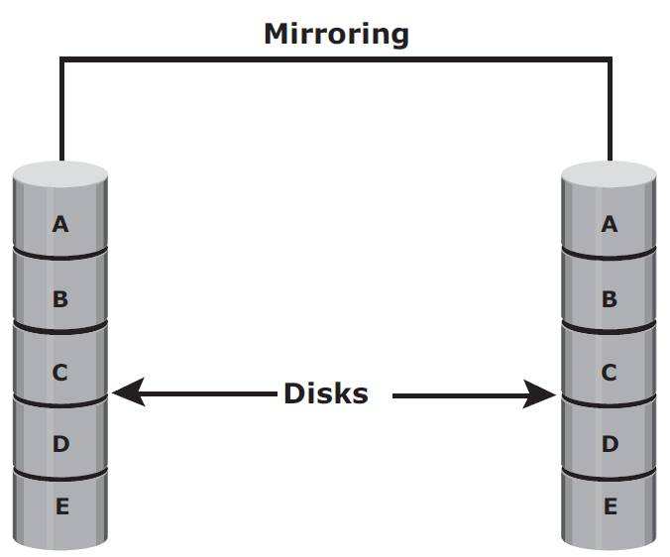
Mirroring
Same data is stored on two different disk drives, yielding two copies of the data
If one disk drive failure occurs, the data is intact on the surviving disk drive

Slide 12
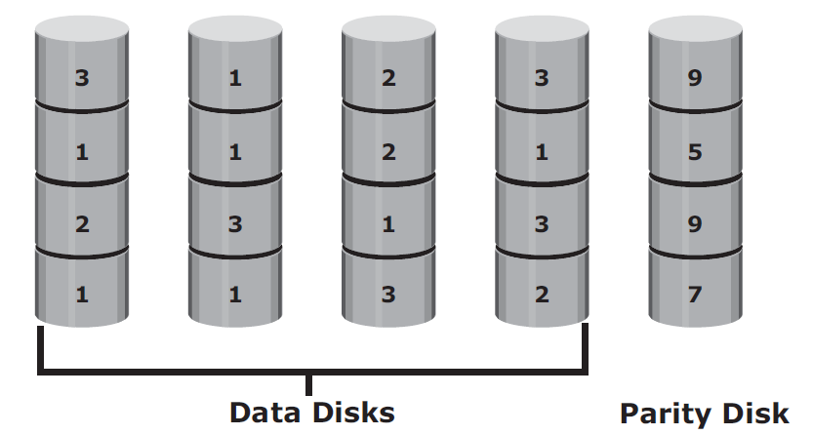
Parity
Protect striped data from disk drive failure without the cost of mirroring.
Parity is a redundancy technique that ensures protection of data without maintaining a full set of duplicate data.
Parity information can be stored on separate, dedicated disk drives.

Slide 13
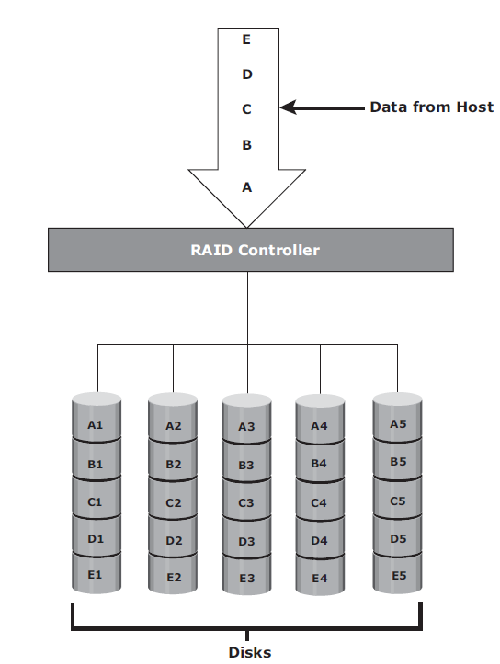
RAID Levels – RAID 0
Data is striped across all the disks within a RAID set
When the system wants to read that data, it can do so simultaneously from all the disks and join them together to reconstruct the entire data stream
Advantages
Performance boost for read and write operations
Space is not wasted as the entire volume of the individual disks are used up to store unique data
Disadvantages
There is no redundancy/duplication of data. If one of the disks fails, the entire data is lost.
Poor availability

Slide 14
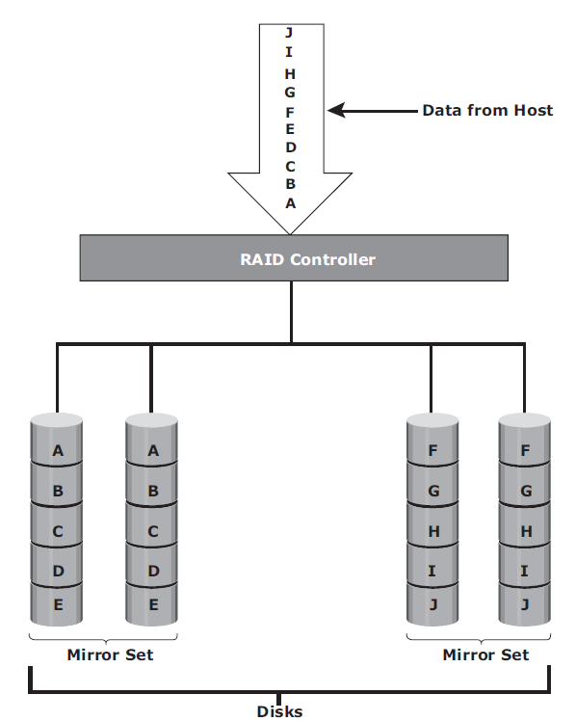
RAID 1
RAID 1 is based on the mirroring technique
A RAID 1 set consists of two disk drives and every write is written to both disks
Advantages
Data can be recovered in case of disk failure
Increased performance for read operation
Disadvantages
Slow write performance
Space is wasted by duplicating data which increases the cost per unit memory

Slide 15
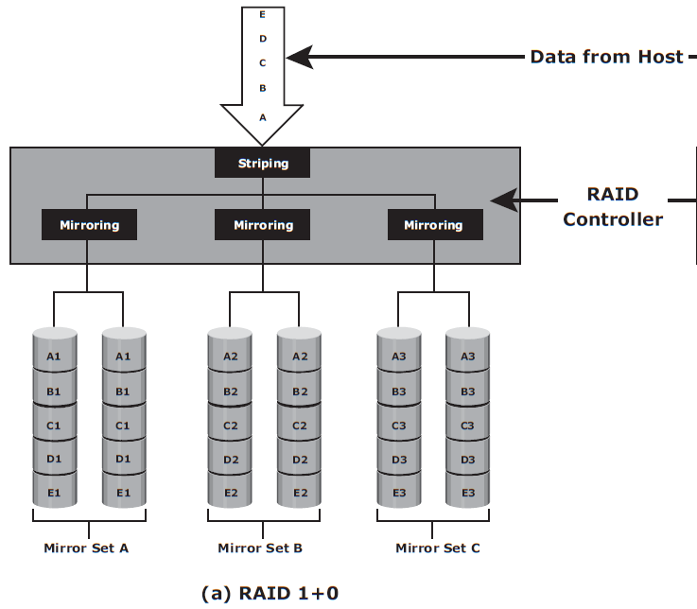
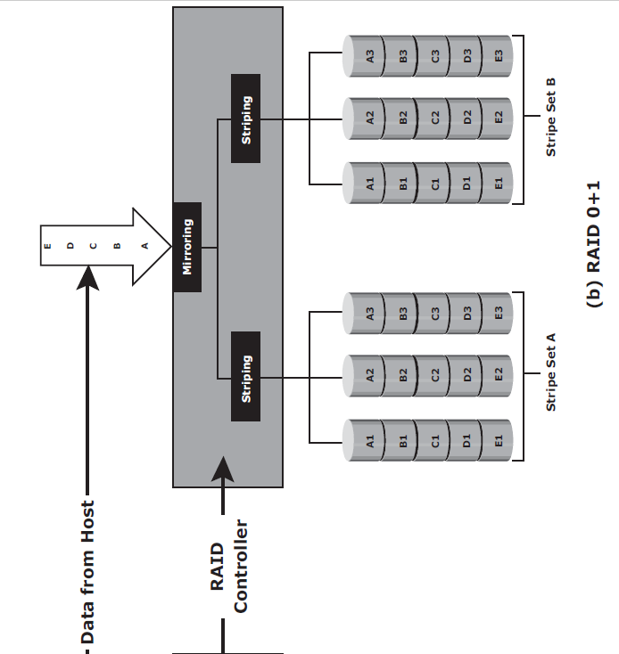
Nested RAID
RAID 1+0 and RAID 0+1combine the performance benefits of RAID 0 with the redundancy benefits of RAID 1 (min 4).

Slide 16
Benefits of RAID 1+0
High transaction rate Online Transaction Processing (OLTP)
Large messaging installations
Database applications with write intensive random access workloads
Is RAID 10 and RAID 01 same?

Slide 17
Example
Consider 6 disks (2 disks in each mirrored set, i.e. 3 sets A, B, C)
RAID 10:
Drives 1+2 = RAID 1 (Mirror Set A)
Drives 3+4 = RAID 1 (Mirror Set B)
Drives 5+6 = RAID 1 (Mirror Set C)
Striping is done for A, B, and C
If drive 5 fails, no issues, because drive 6 is still available
RAID 01
six disks are paired into two sets (stripe set A and B) of three disks each
Drives 1 + 2 + 3 = RAID 0 (Stripe Set A)
Drives 4 + 5 + 6 = RAID 0 (Stripe Set B)
If disk 3 fails, i.e. stripe set A fails. Copy from set B. Increase in I/O

Slide 18
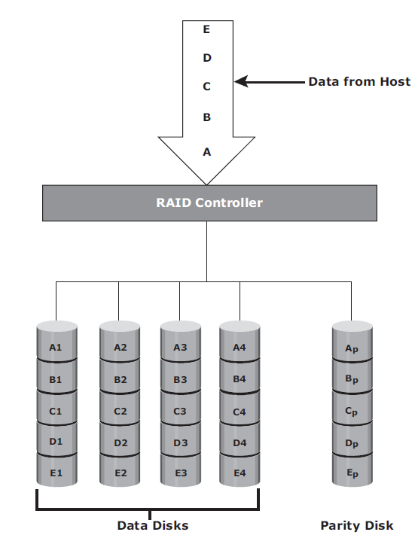
RAID 3
RAID 3 stripes data for performance and uses parity for fault tolerance.
Parity information is stored on a dedicated drive so that the data can be reconstructed if a drive fails in a RAID set
Good for video streaming and data backup
Advantages: low failure and high read speed
Disadvantages: low write speed, when disk fails, low system performance, cost of computing parity/checksum

Slide 19
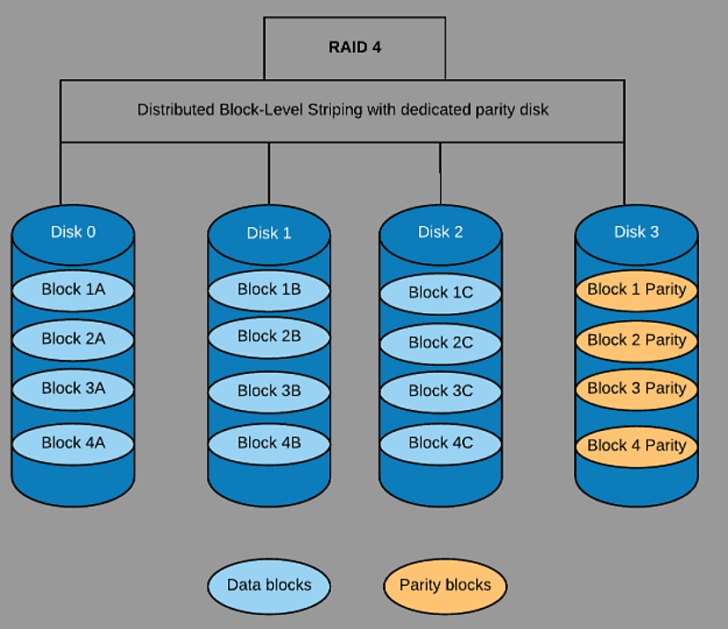
RAID 4
RAID 4 stripes block-level data across all disks in the RAID configuration.
However, parity information is stored in a dedicated disk.
Data is saved in blocks 1A, 1B and 1C and stripped across Disk 0, 1 and 3.
The parity bit for data block 1 is stored in disk 3 as block 1 parity.
Advantages
Offers improved parallel Read performance
Low storage overhead – lowers with more disk.
Unlike RAID 3, RAID 4 disks do not need to synchronize disk spindles
Disadvantages
Dedicated parity drive may cause bottleneck
Simultaneous Write operation is slow because parity information are written to one disk

Slide 20
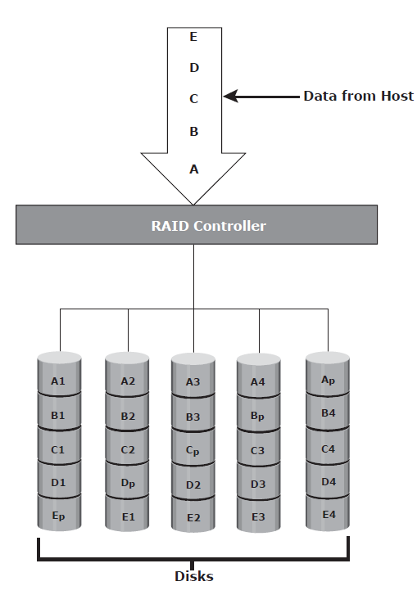
RAID 5
Same as RAID 4, since it uses striping
Parity is distributed across all disks to overcome the write bottleneck of a dedicated parity disk
Applications:
RAID 5 is good for random, read-intensive I/O applications
for messaging
data mining
medium-performance media serving
RDBMS implementations

Slide 21
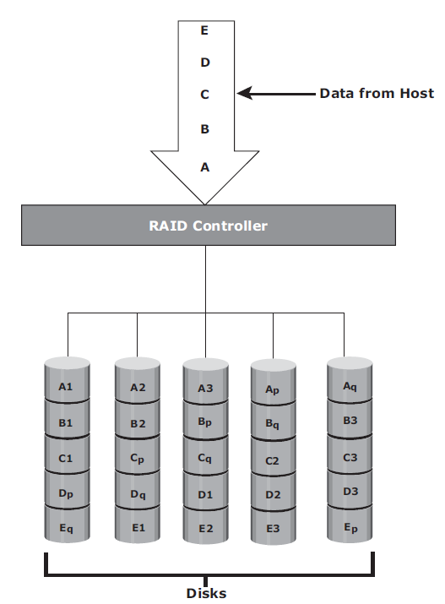
RAID 6
Same as RAID 5, except that RAID 6 includes a second parity element to enable survival if two disk failures occur in a RAID set
rebuild operation may take more time
Applications:
Very high fault- and drive-failure tolerance and can be used for environments that need long Data retention periods, such as archiving.
Useful for mission critical applications
RAID 6 uses less storage

Slide 22
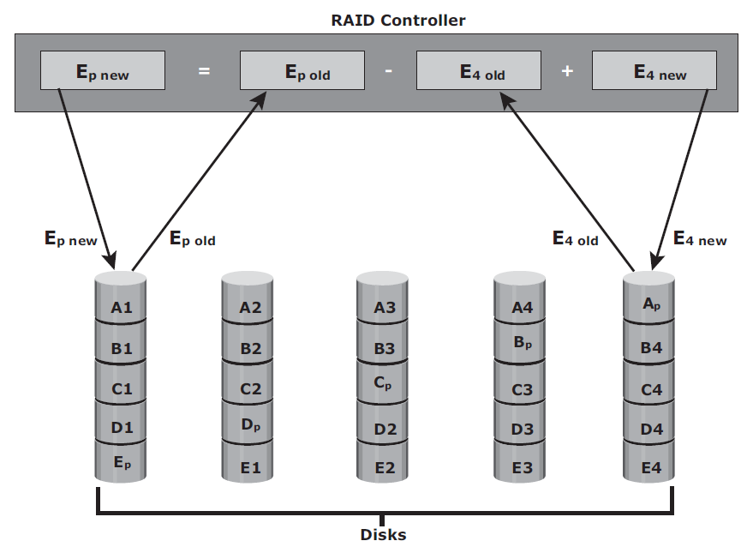
RAID Impact on Disk Performance
Write penalty - In both mirrored and parity RAID configurations, every write operation translates into more I/O overhead for the disks
In RAID 1– every write operation in 2 disks
In RAID 5 - every write operation manifest as 4 I/O operations
The parity (P) at the controller is calculated as follows:
Whenever the controller performs a write I/O, parity must be computed as (two reads of “old” values)

Slide 23
Parity Calculation
Assume 3 disks in RAID 5
2 disks for data and one disk for parity
Imagine: Disk 1 – ‘a’ is stored and Disk 2 – ‘b’ is stored
Parity = ‘a’ XOR ‘b’ ============➔
Reconstruction:
Imagine we have lost the first disk where the value ‘a’ (or ‘b’) was stored:
0110 0001 (Decimal 97 = ‘a’)
0110 0010 (Decimal 98 = ‘b’)
==============================
0000 0011 (Decimal 3 – Parity)
0110 0010 (Decimal 98 = ‘b’)
0000 0011 (Decimal 3 – Parity)
==============================
0110 0001 (Decimal 97 = ‘a’)
0110 0001 (Decimal 97 = ‘a’)
0000 0011 (Decimal 3 – Parity)
==============================
0110 0010 (Decimal 98 = ‘b’)

Slide 24
Application IOPS and RAID Configurations
The total disk load = type of RAID configuration and the ratio of read compared to write from the host.
Example
Consider an application that generates 5,200 IOPS, with 60% of them being reads.
The disk load in RAID 5 is calculated as follows:
RAID 5 disk load (reads + writes)
= {0.6 x 5,200} + {4 x (0.4 x 5,200)} [because the write penalty for RAID 5 is 4]
= 3,120 + 4 x 2,080
= 3,120 + 8,320
= 11,440 IOPS

Slide 25
Disk Load in RAID 1
RAID 1 disk load = {0.6 x 5,200} + {2 x (0.4 x 5,200)} [because every write manifests as two writes to the disks]
= 3,120 + 2 x 2,080
= 3,120 + 4,160
= 7,280 IOPS
# of disks required (assume max 180 IOPS/disk)
RAID 5: 11,440/180 = 64 disks
RAID 1: 7,280/180 = 42 disks

Slide 26
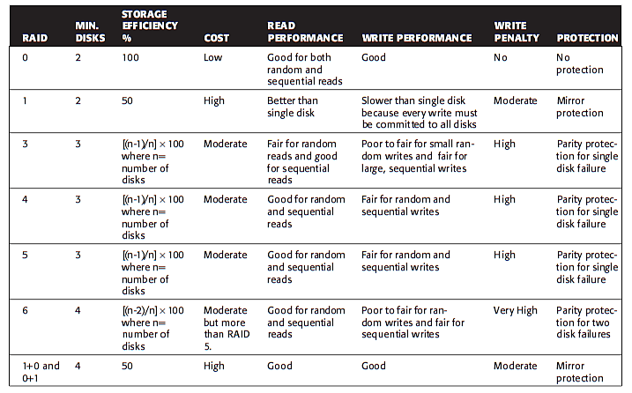
RAID Comparison

Slide 27
Chapter 4: Intelligent Storage Systems

Slide 28
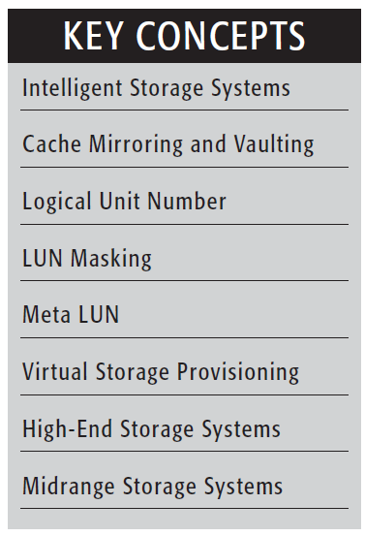
Introduction
The intelligent storage systems are feature-rich RAID arrays that provide highly optimized I/O processing capabilities.
These storage systems are configured with a large amount of memory (called cache) and multiple I/O paths
Uses sophisticated algorithms to meet the requirements of performance-sensitive applications

Slide 29
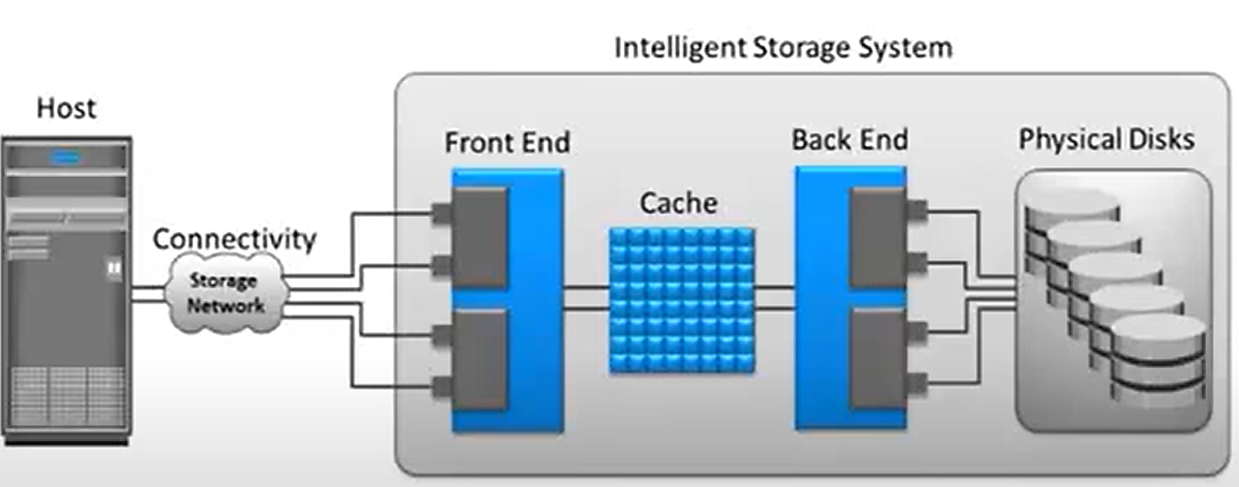
Components of an Intelligent Storage System
Key components: front-end, cache, back-end, and physical disks.

Slide 30
Front End
Two components : front-end ports and front-end controllers
Front-end controller –
processing logic that executes the appropriate transport protocol, such as Fibre Channel, iSCSI, FICON, or FCoE for storage connections.
route data to and from cache via the internal data bus.
when the cache receives the write data, the controller sends an acknowledgment message back to the host.

Slide 31
Cache
Cache is semiconductor memory where data is placed temporarily to reduce the time required to service I/O requests from the host.
Cache improves storage system performance by isolating hosts from the mechanical delays associated with rotating disks or hard disk drives (HDD).

Slide 32
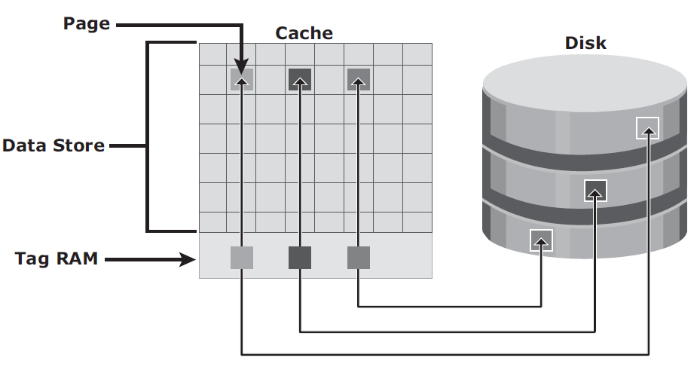
Structure of Cache
Cache is organized into pages, which is the smallest unit of cache allocation
Cache consists of the data store and tag RAM.
The data store holds the data whereas the tag RAM tracks the location of the data in the data store and in the disk.
Tag RAM includes a dirty bit flag, which indicates whether the data in cache has been committed to the disk

Slide 33
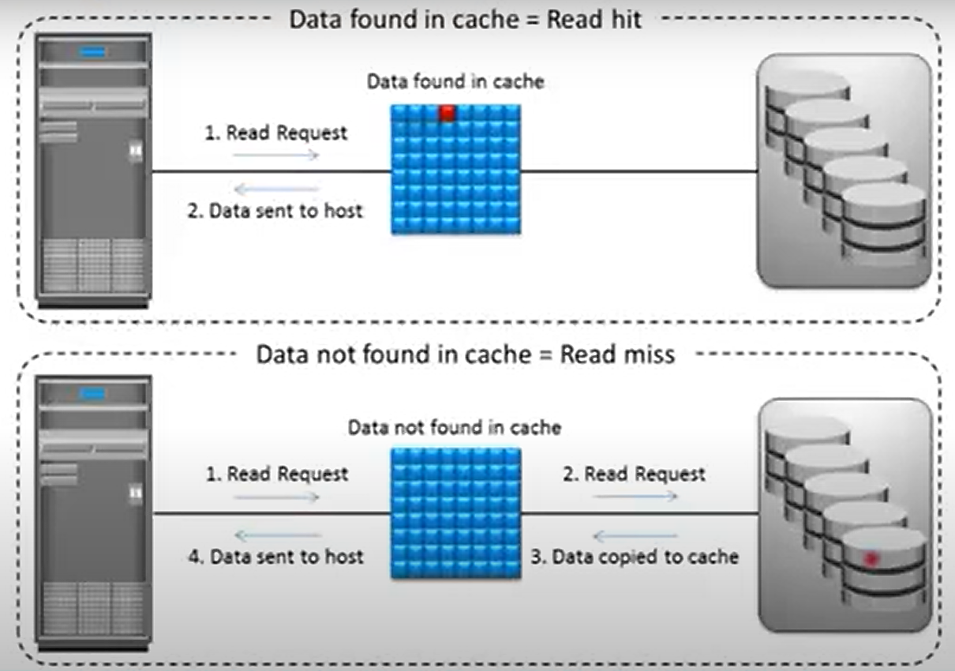
Read Operation with Cache
When a host issues a read request, the storage controller reads the tag RAM to determine whether the required data is available in cache.
If yes, it is called a read cache hit or read hit and data is sent directly to the host, without any disk operation.
If data not found in cache, cache miss.
Disk request initiated

Slide 34
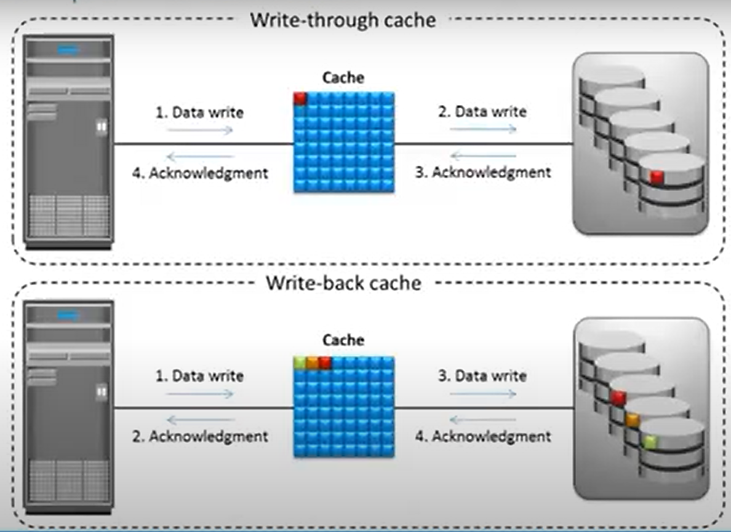
Write Operation with Cache
Write-back cache: Data is placed in cache and an acknowledgment is sent to the host immediately. Later, data from several writes are committed (de-staged) to the disk.
Write-through cache: Data is placed in the cache and immediately written to the disk, and an acknowledgment is sent to the host

Slide 35
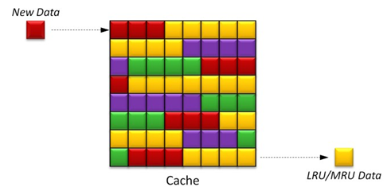
Cache Management
When all cache pages are filled, some pages have to be freed up to accommodate new data and avoid performance degradation.
Least Recently Used (LRU): discards data that have not been used for a longer time
Most Recently Used (MRU): Discards data that have been most recently used

Slide 36
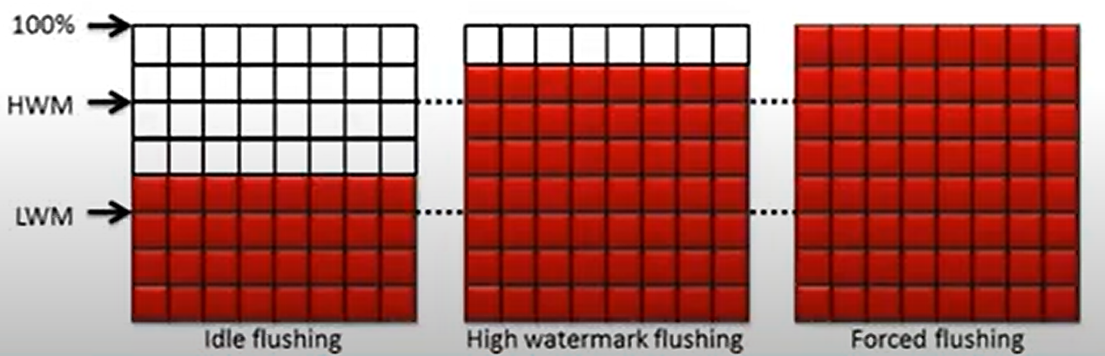
Cache Management: Watermarking
Idle flushing: Occurs continuously, at a modest rate, when the cache utilization level is between the high and low watermark.
High watermark flushing: Activated when cache utilization hits the high watermark
Forced flushing: Occurs in the event of a large I/O burst when cache reaches 100 percent of its capacity

Slide 37
Cache Data Protection
This risk of losing uncommitted data held in cache can be mitigated using cache mirroring and cache vaulting.
Cache mirroring: Each write to cache is held in two different memory locations on two independent memory cards.
If a cache failure occurs, the write data will still be safe in the mirrored location and can be committed to the disk.
Cache vaulting: The risk of data loss due to power failure can be addressed in various ways.
Powering the memory with a battery until the AC power is restored or using battery power to write the cache content to the disk.

Slide 38
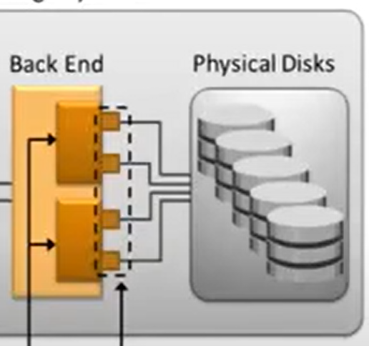
Back End
The back end provides an interface between cache and the physical disks.
It consists of two components: back-end ports and back-end controllers.
The back-end controls data transfers between cache and the physical disks.
From cache, data is sent to the back end and then routed to the destination disk.
Physical disks are connected to ports on the back end.
The back-end controller communicates with the disks when performing reads and writes

Slide 39
Physical Disk
Physical disks are connected to the back-end storage controller and provide persistent data storage.
Modern intelligent storage systems provide support to a variety of disk drives with different speeds and types, such as FC, SATA, SAS, and flash drives

Slide 40
Storage Provisioning *
Storage provisioning is the process of assigning storage resources to hosts based on capacity, availability, and performance requirements of applications running on the hosts.
Storage provisioning can be performed in two ways: traditional and virtual.
*Topics beyond the syllabus

Slide 41
Traditional Storage Provisioning
Physical disks are logically grouped together and a required RAID level is applied to form a set, called a RAID set.
The number of drives in the RAID set and the RAID level determine the availability, capacity, and performance of the RAID set.
Can we group different capacity disks? EMC² Storage integrator tool.
Partitioning the available capacity into smaller units – Logical Units
Each logical unit created from the RAID set is assigned a unique ID – LUN (Logical Unit Number)

Slide 42
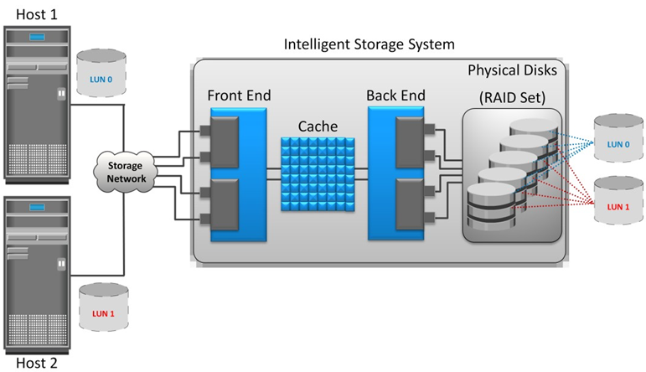
Thick LUN

Slide 43
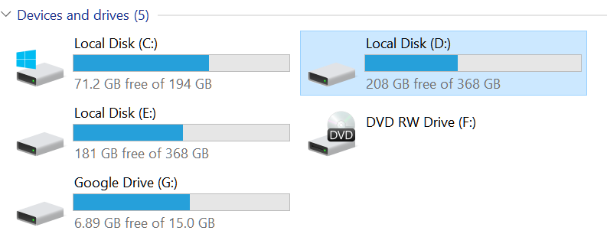
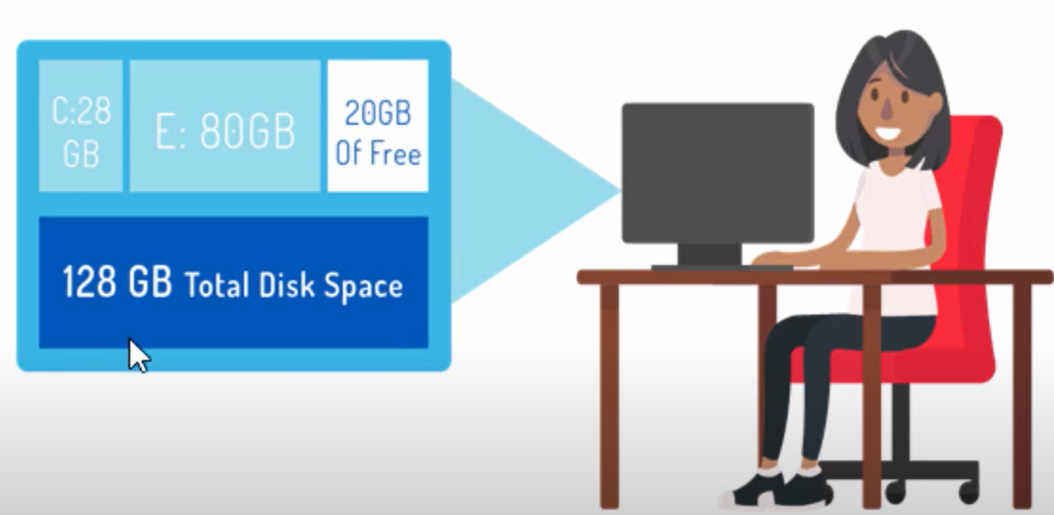
Example

Slide 44
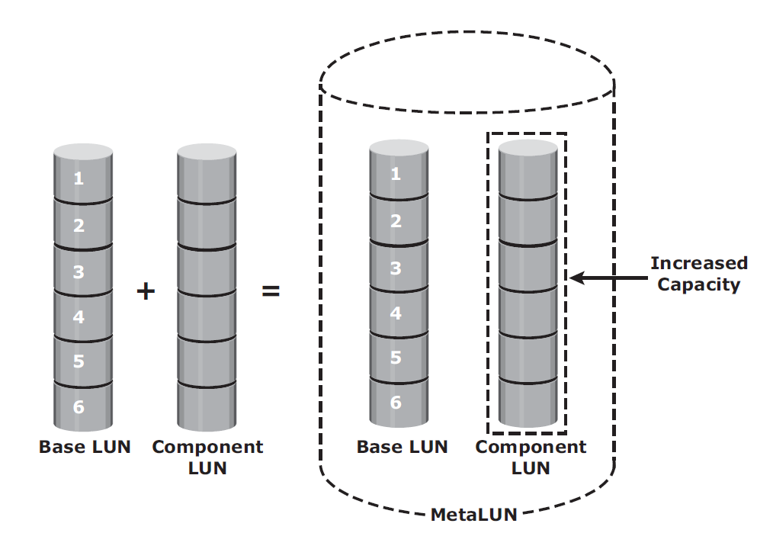
MetaLUN
MetaLUN is a method to expand LUNs that require additional capacity or performance.
MetaLUNs can be either concatenated or striped.

Slide 45
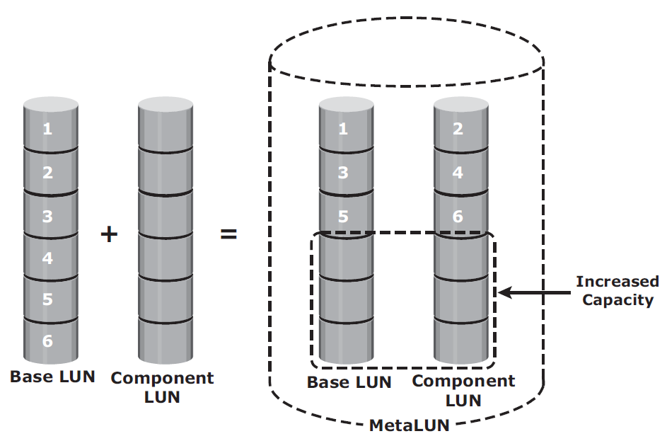
Striped metaLUN

Slide 46
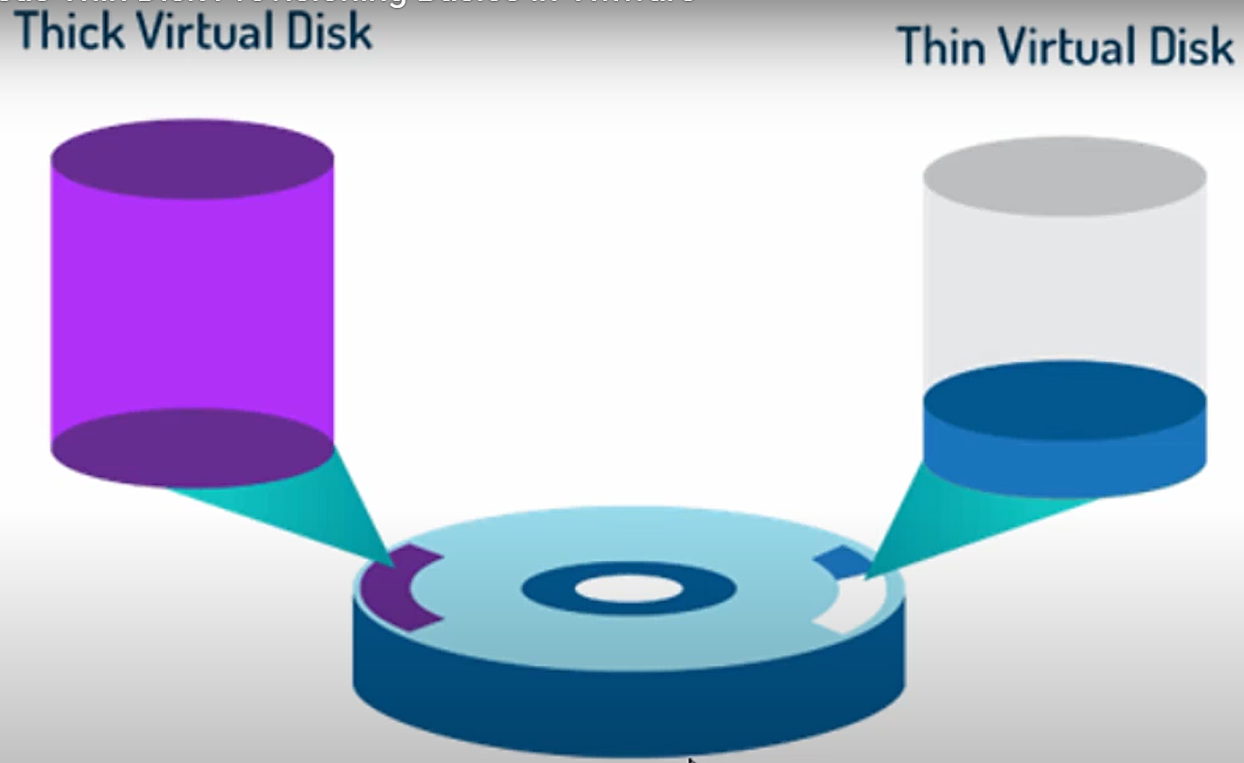
Virtual Storage Provisioning (thin LUN)
Virtual provisioning enables creating and presenting a LUN with more capacity than is physically allocated to it on the storage array
Physical storage is allocated to the host “on-demand” from a shared pool of physical capacity (set of disks)

Slide 47
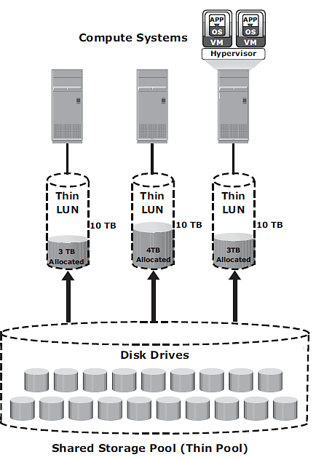
Thin LUN…

Slide 48
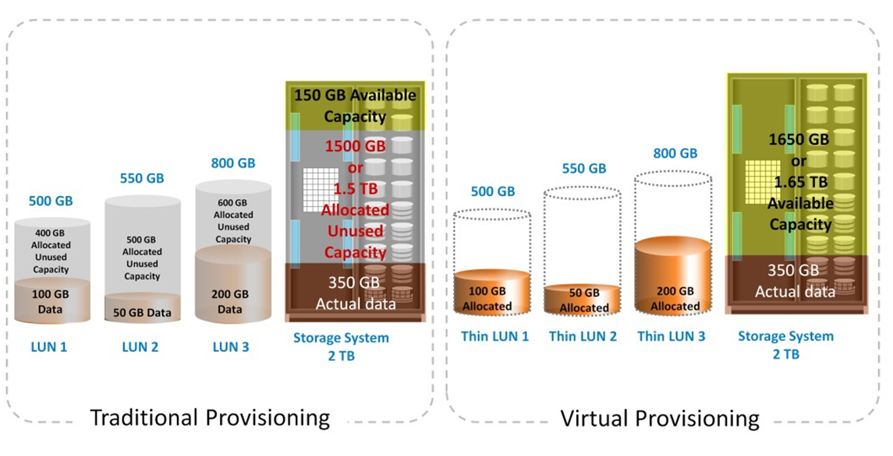
Thick LUN vs. Thin LUN
Thick LUN
Thin LUN

Slide 49
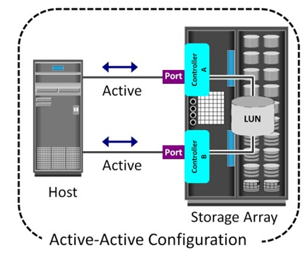
Types of Intelligent Storage Systems
High-end storage systems (active-active arrays)
The host can perform I/Os to its LUNs through any of the available controllers (for large enterprises)
Capabilities
Large storage capacity
Large amounts of cache to service host I/Os optimally
Fault tolerance architecture to improve data availability
Connectivity to mainframe computers and open systems hosts
Availability of multiple front-end ports and interface protocols to serve a large number of hosts
Availability of multiple back-end controllers to manage disk processing
Scalability to support increased connectivity, performance, and storage capacity requirements
Ability to handle large amounts of concurrent I/Os from a number of hosts and applications
Support for array-based local and remote data replication
active-active arrays

Slide 50
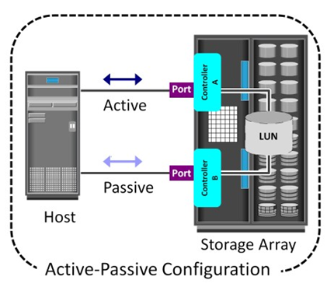
Midrange Storage Systems
Midrange storage systems are also referred to as active-passive arrays and are best suited for small- and medium-sized enterprise applications.
The host can perform reads or writes to the LUN only through the path to controller A because controller A is the owner of that LUN.
The path to controller B remains passive and no I/O activity is performed through this path.

Slide 51
Chapter 5: Fibre Channel Storage Area Networks

Slide 52
Overview
A fiber channel storage area network (FC SAN) is a system that enables multiple servers to access network storage devices.
Fibre Channel (FC) is a high-speed data transfer protocol providing in-order, lossless delivery of raw block data.
Fibre Channel is primarily used to connect computer data storage to servers in storage area networks (SAN) in commercial data centers (scalable - 15 million devices).
Fibre Channel typically runs on optical fiber cables within and between data centers (data rates include 1, 2, 4, 8, 16, 32, 64, and 128 gigabit per second)
Goal of FC - to create a storage area network (SAN) to connect servers to storage.

Slide 53
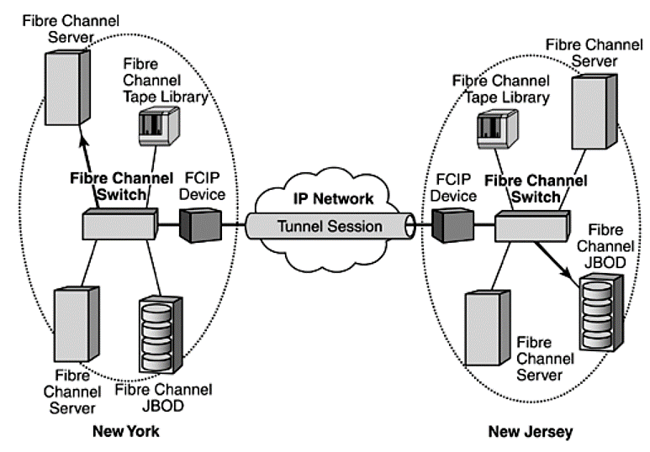
Example

Slide 54
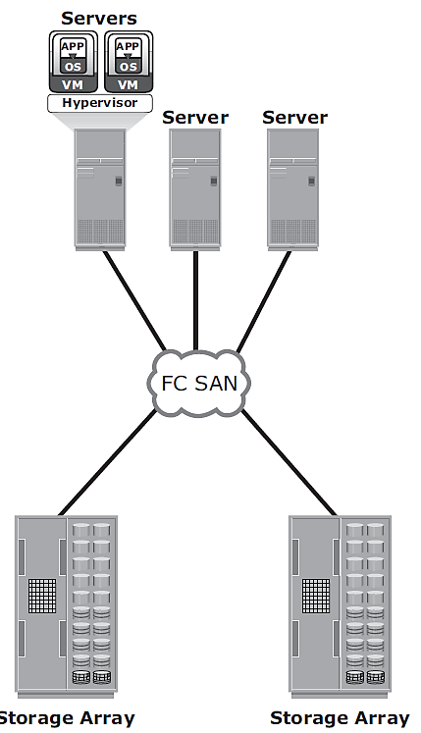
The SAN and Its Evolution
FC SAN - a simple grouping of hosts and storage devices connected to a network using an FC hub as a connectivity device.
This configuration of an FC SAN is known as a Fibre Channel Arbitrated Loop (FC-AL).

Slide 55
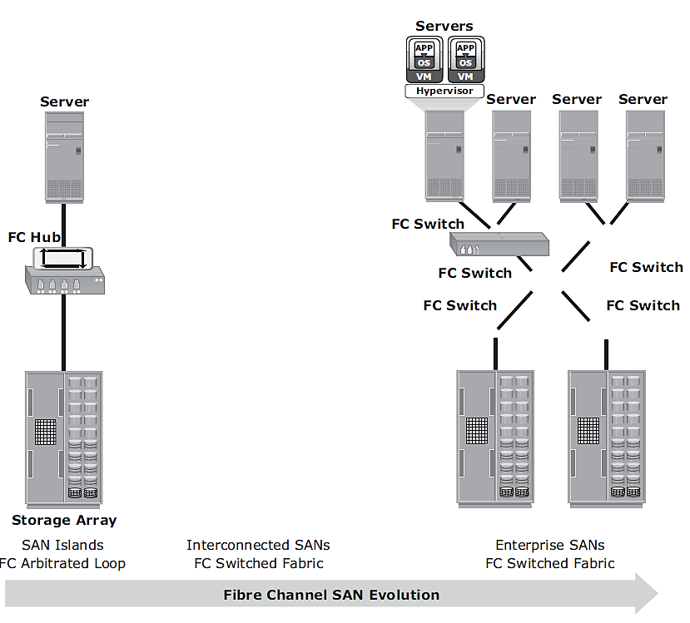
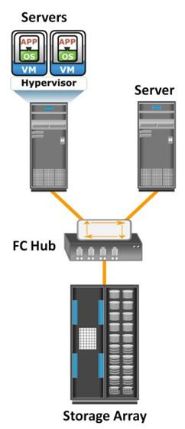
FC SAN Evolution (contd.)

Slide 56
Components of FC SAN
Platform devices
Fabric-attached end devices, including servers, hosts and storage subsystems
Devices connected to other SAN platforms via fabric facilities
One or more FC nodes, including host adapters, host bus adapters, storage controllers and one or more node ports controlled at levels of FC-2 or higher
Interconnected device fabric, including switches, hubs and bridges, and generic node port fabric references

Slide 57
Review Questions
Discuss the concept of mirroring and parity.
Explain RAID 0 and RAID 1 with neat diagrams.
What is RAID? Explain RAID levels with respect to nested RAID, RAID 3, and RAID 5 with a neat diagram.
List the different RAID levels where parity technique is adopted.
Differentiate between software and hardware RAID technology.
Imagine you have 3 disks called A, B, and C. Disk C is used for parity storage with A and B for data. If A (or B) fails how is the data recovered from the parity and the other alive disk? Show an example.
Discuss the components of an intelligent storage system with a neat diagram.
With a neat diagram explain the structure of read write operations in cache.
Describe methods for cache implementation and management in an intelligent Storage system.
Compare thin LUN and thick LUN.
List and explain different fiber channel connectivity options with a neat diagram.
Explain with a neat diagram the components of Fiber Channel (FC) storage area networks.

